Slide 1
Scale and Performance in a Distributed File System
JOHN H. HOWARD, MICHAEL L. KAZAR, SHERRI G. MENEES, DAVID A. NICHOLS, M. SATYANARAYANAN, ROBERT N. SIDEBOTHAM, and MICHAEL J. WEST
Presenters : MA Lin & WU Junde

Slide 2
Outline
Andrew File System
Introduction of AFS
Performence Evaluation of AFS Prototype
Improvement
Revised Andrew File System
The effect of revised AFS
The scalability compared to the NFS
Changes for operability
Conclusion

Slide 3
Part 1
Andrew File System

Slide 4
What is Distributed File System
A distributed implementation of a file system, where multiple users share files and storage resources.
Overall storage space managed by a DFS is composed of different, remotely located, smaller storage spaces

Slide 5
Caching in DFS
Retaining most recently accessed disk blocks.
Repeated accesses to a block in cache can be handled without involving the disk.
Reduce network traffic and server contention
Notes:
保留最近

Slide 6
Andrew File System
Developed at CMU since 1983
Client-server model
Key software: Vice and Venus
Goal: high scalability (5,000-10,000 workstations)
4.2 BSD

Slide 7
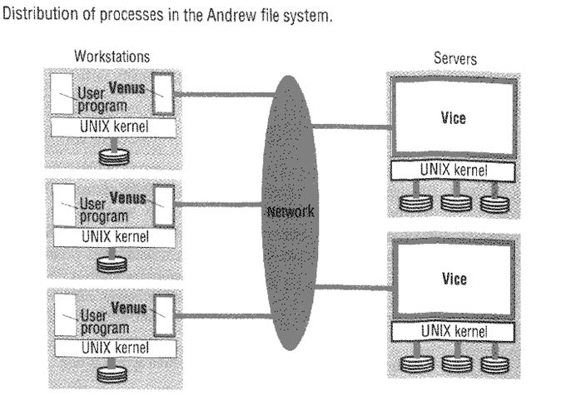
Prototype of AFS
Vice (Server) :
A set of trusted servers, collectively called Vice
A Vice process dedicated to each Venus client
Venus (Client) :
The user-level process which caches files from Vices and stores modified copies of files back on the servers they came from
Contacts Vice only when a file is opened or closed
Reading and writing are performed directly on the cached copy(client side)
Notes:
client端有一个cache manager

Slide 8
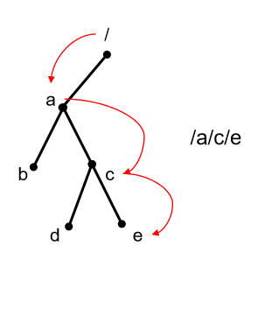
Prototype of AFS (cont’d)
Data and associated Vice status informatin were stored in separate files.
Each server contained a directory hierarchy mirroring the structure of the Vice files stored on it.
.admin: store Vice file status information
Stub: represent portions of the Vice name space located on other servers.
If a file were not on a server, the search for its name would end in a stub directory
Vice- Venus interface named files by their full pathname
.admin
Stub
stub

Slide 9
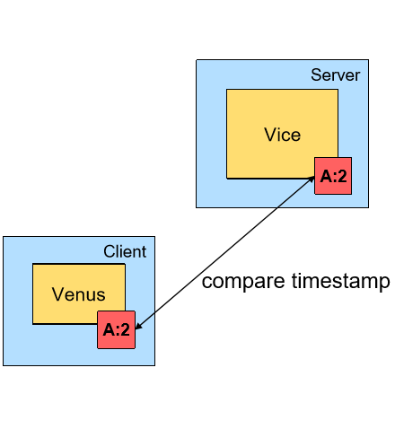
Prototype of AFS (cont’d)
The dedicated process persisted until its client terminated
Venus verify timestamps on every open

Slide 10
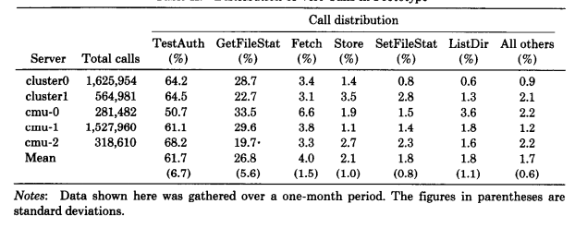
Performance Observation
TestAuth call valided cache entries
GetFileStat obtained status information about files absent from the cache.
These 2 calls counting for nearly 90 percent of total !
Distribution of Vice Calls in Prototype

Slide 11
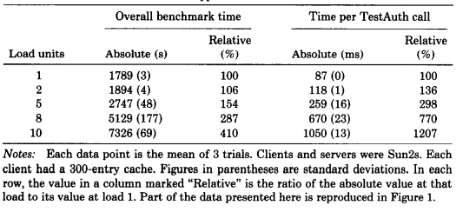
Performance Observation (cont’d)
The average response time for the most frequent Vice operation, TestAuth.
Benchmark took about 70 perncent longer at a load of 1 than in the stand-alone case.
The tine for TestAuth rose rapidly beyond a load of 5, indication server saturation.
Total running time for the the benchmark as a funtion of server load

Slide 12
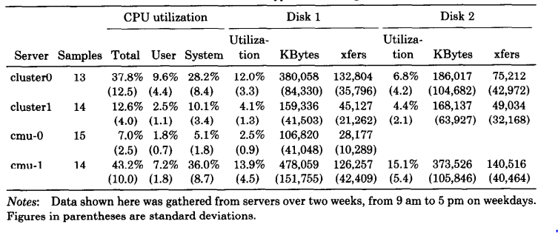
Performance Observation (cont’d)
CPU utilisation: the servers loads were not evenly balanced.
(Moving users to less heavily loaded servers would have improved the quality of service considerably.)
Disk Utilisation: much more lower. The 8-hour average was less than 15 percent
Conclusion: Bottleneck is server CPU
Prototype Servers Usageb

Slide 13
Conclusion of the observation
The measurements indicte that significant perfornance improvement is possible if we reduce the frequency of cache validity checks, reduce the number of server processes, require workstations rather than the servers to do path name traversals, and balance server usage by reassigning users.

Slide 14
Improvement
Use the same fundamental architectural principle as the prototype
The changes fall into two categories :
Enhance performance
Improve the operability of the system

Slide 15
Improvement (cond’t)
Cache Management
CallBack : Rather than checking with a server on each open, when a workstation caches a file or directory, the server promises to notify it before allowing a modification by any other workstation.
When a workstatin is rebooted, Venus considers all cached files and directiories suspect and generates a cache validation request for the first use of each such entry.
Result : Dramatically reduces the number of cache validation requests received by servers.

Slide 16
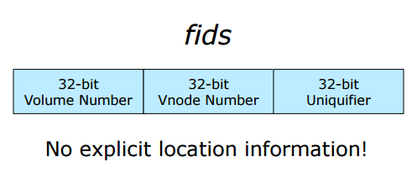
Improvement (cont’d)
2 . Name Resolution
Implicit namei in Venus was costly
Two-level names: Each Vice file or directory is identified by a unique fixed-length Fid. Servers are presented with fids and are, in fact, unaware of pathnames.
A fid is 96 bits long and 3 components :
32-bit Volume number : Identiier a Collection of files located on one server
32-bit Vnode number : Used as an index into an array containing the file storage information for the files in a sing volume
32-bit Uniquifier : No fid is ever used twince in the history of the file system. Allows reuse of vnode numbers

Slide 17
Improvement (cont’d)
3. Communication and Server Process Structure
Problem : Server processes could not cache critical shared informatin in their address spaces because 4.2BSD dose not permit processes to share vitural memory
Improvement :
Using a single process to service all clients of a server.
LWP : Nonpreemptive Lightweight Processes within one process
RPC Mechanism : Support many hundreds or thousands of clients per server.

Slide 18
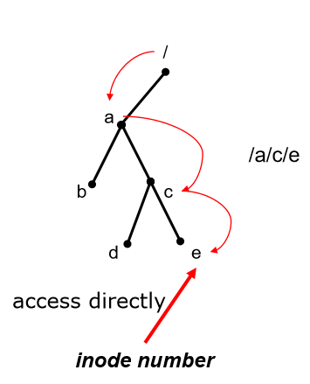
Improvement (cont’d)
4. Low-level Storage Representation
Access files by their inodes rather by pathnames.
Eliminated nearly all pathname lookups on workstations and servers

Slide 19
Revised Andrew File System
Part 2

Slide 20
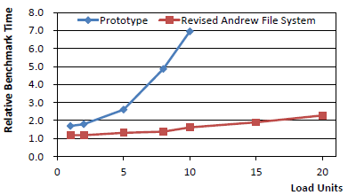
Revised AFS Benchmark Result
19% slower than a
stand-alone workstation
takes less than twice as long
at a load of 20 as at a load of 1

Slide 21
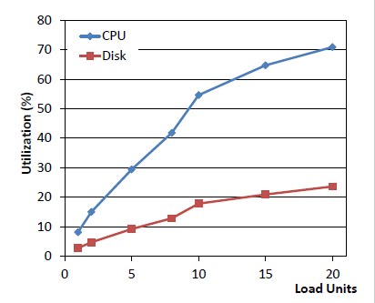
Server utilization during the benchmark
Utilization
CPU utilization rises from about 8 percent at a load of 1 to over 70 percent at a load of 20
But disk utilization is below 25 percent even at a load of 20.
the server CPU still limits performance in our system
Summary
design changes have improved scalability considerably

Slide 22
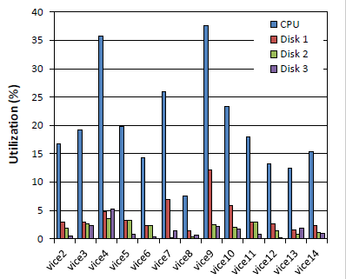
Andrew Server Usage
Most of servers show CPU utilizations between 15% and 25%
High utilization
V4
caused by system maintenance activities that were performed during the unexpectedly period.
V9
this server stores the bulletin boards which are accessed and modified by many different users.

Slide 23
COMPARISON WITH A REMOTE-OPEN FILE SYSTEM
The caching of entire files on local disks in the Andrew File System was motivated by the following considerations of scale:
locality of file references by typical users makes caching attractive.
whole-file transfer approach contacts servers only on opens and closes.
whole-file transfer uses efficient bulk data transfer protocols.
the amount of data fetched after a reboot is usually small.
caching of entire files simplifies cache management.

Slide 24
The drawbacks of the approach
Workstations require local disks for acceptable performance. Files that are larger than the local disk cache cannot be accessed
Strict emulation of 4.2BSD concurrent read and write semantics across workstations is impossible
But the drawbacks listed above have not proved to be significant in actual usage in our environment.And the Andrew File System does scale well.

Slide 25
Remote Open
Selected Sun Microsystem’s NFS as the candidate for comparison for the following reasons:
NFS is a mature product from a successful vendor of distributed computing hardware and software.
Sun has spent a considerable amount of time and effort to tune and refine NFS.
NFS and Andrew can run on precisely the same hardware and operating system.
There is a perception in the 4.2BSD user community that NFS is a de facto standard.

Slide 26
The Sun Network File System
NFS does not distinguish between client and server machines
NFS caches inodes and individual pages of a file in memory.
Neither provides strict emulation of 4.2BSD semantics, nor the open/close action consistency of Andrew.

Slide 27
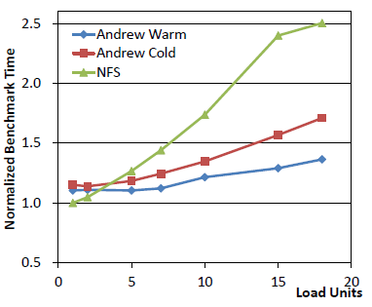
Results of Comparison
Cold Cache set ：in which workstation caches were cleared before each trial
Warm Cache set： in which caches were left unaltered.
NFS performs slightly better than Andrew at low loads, but its performance degrades rapidly with increasing load.

Slide 28
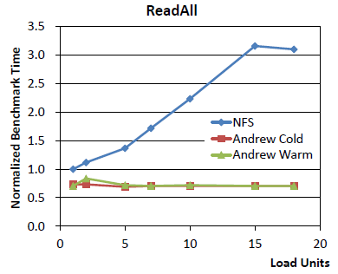
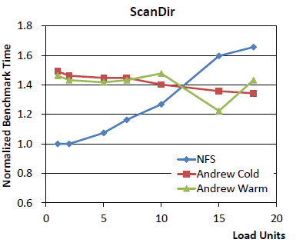
Results of Comparison
Caching and callback in Andrew result in having the time for these phases only slightly affected by load
NFS lack of a disk cache and the need to check with the server on each file open cause it is more load dependent
Andrew well scales especially on ScanDirand ReadAllthan NFS

Slide 29
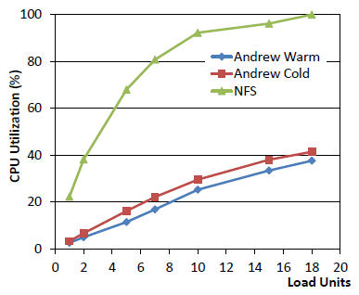
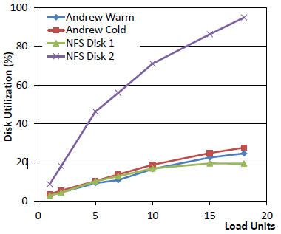
CPU Utilization & Disk Utilization
CPU utilization of NFS is much higher than AFS
NFS used both disks on the server,users’ data disk utilizations rising from about 9% at a load of 1 to nearly 95% at a load of 18

Slide 30
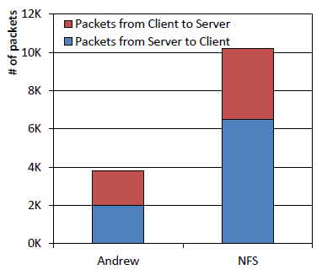
Relative amount of Network Traffic
NFS generates nearly three times as many packets as Andrew at a load of one.

Slide 31
Conclution
Andrew’s scaling characteristics are superior to those of NFS.
The improved scaling of Andrew is not achieved at the price of substantially poorer small-scale performance.
Andrew provides a well-defined consistency semantics, as well as support for security and operability.

Slide 32
Changes for Operability
At the heart of the operability problems in the prototype was an inflexible mapping of Vice files to server disk storage.This mapping was deficient in a number of ways:
Vice was constructed out of collections of files glued together by the 4.2BSD Mount mechanism.
The embedding of file location information in the file storage structure made movement of files across servers difficult.
It was not possible to implement a quota system

Slide 33
CHANGES FOR OPERABILITY
4. The mechanisms for file location and for file replication were cumbersome because of the lack of well-defined consistency guarantees.
5. Standard utilities were used to create backup copies of the files in the system.
6. Backup was further complicated

Slide 34
CHANGES FOR OPERABILITY
Volume
a collection of files forming a partial subtree of the Vice name space
glued together at Mount Points to form the complete name space.
a volume resides within a single disk partition on a server and may grow or shrink in size.
convenient to associate a separate volume with each user.

Slide 35
CHANGES FOR OPERABILITY
Volume movement
Accomplished by creating a frozen copy-on-write snapshot of the volume called a Clone, shipping it to the new site, and regenerating the volume at the remote site
During movement, the volume location database is updated

Slide 36
CHANGES FOR OPERABILITY
Quotas
are implemented in this system on a per volume basis.
Read-Only Replication
improves availability and balances load.
No callbacks
The volume location database specifies the server containing the read-write copy of a volume and a list of read-only replication sites.
Backup
creating a frozen snapshot of those files then transfers this clone to a staging machine from where it is dumped to tape.

Slide 37
Conclusion
Design changes in the Prototype Andrew File System improved scalability considerably
Volumes provide a level of Operational Transparency that is not supported by any other file system

Slide 38
Thank you

